Slide 1
REAL-TIME ENERGY CONSUMPTION MONITORING USING AI BASED NILM SYSTEM (P2123)
Supervisor
Engr. Umer Farooq
Co-Supervisor
Dr. Hafiz Zia Ur Rehman
Members
Muhammad Salman (211291)
Muhammad Mahmood Ghauri (211265)
Muhammad Moin Dildar (211201)

Slide 2

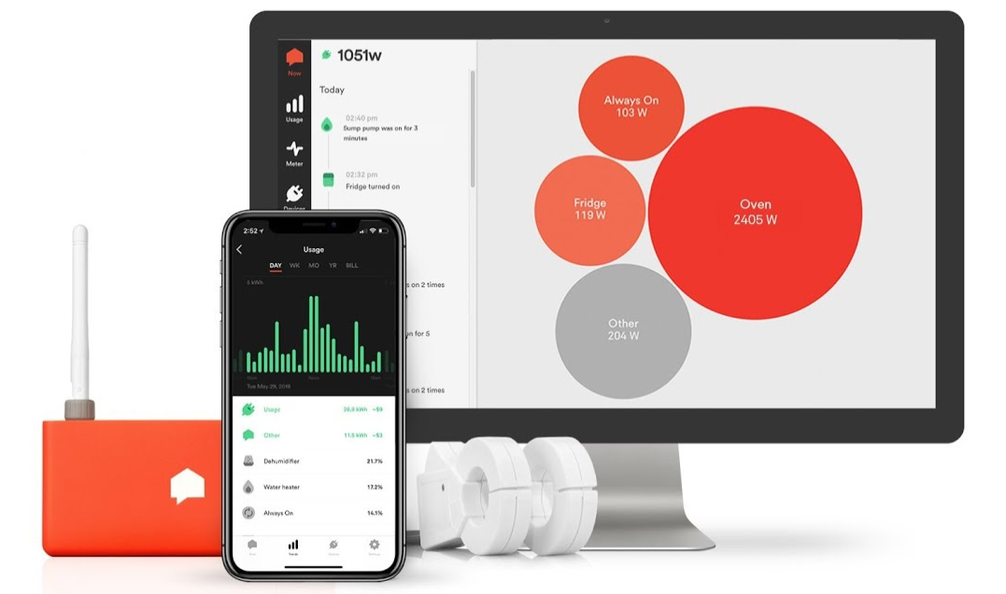
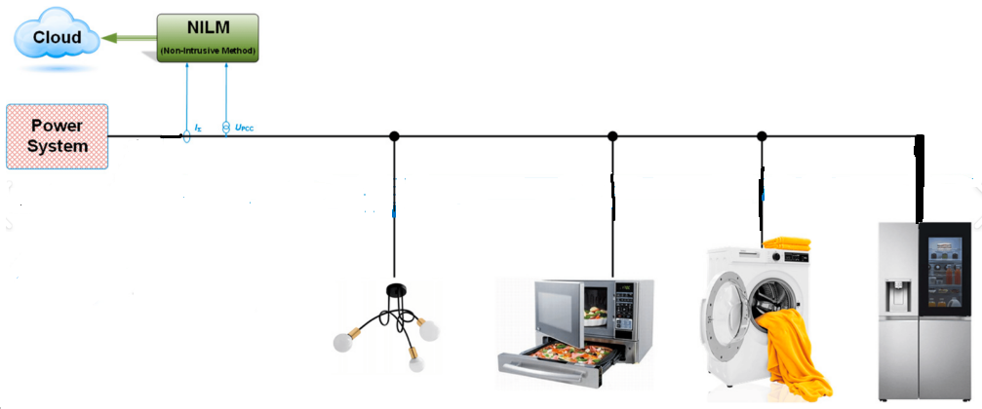
Introduction
AI-based NILM system aims to provide a real-time energy consumption monitoring solution for residential and commercial buildings. The system will utilize advanced AI algorithms and data analytics to identify and predict the energy consumption patterns of individual appliances. Covering SDG7 & SDG 13.
P2123
(Department of Mechatronic & Biomedical Engineering, AIR University, Pakistan)

Slide 3
Literature Review
References | Method | Focus | Key Takeaway
Merri et al. (2023) | Embedded Deep Learning (CNN) for NILM | Year-long field study in real houses | Edge processing for NILM with promising results for widespread adoption
M.I.Azad et al. (2023) | Deep Learning for NILM | NILM accuracy and challenges | Importance of considering real-time load variations and new appliance identification.
C. L. Athanasiadis et al.(2021) | Convolutional neural network (CNN) | Real-time NILM with high accuracy | Lightweight and scalable architecture achieves over 99% accuracy.

Slide 4
Problem Statement
Current energy management lacks real-time monitoring of Individual Appliances, resulting in inefficiencies. This project aims to implement an AI-based NILM system for real-time energy consumption monitoring of Individual Appliances, promoting efficiency and sustainability.
Objectives
Identifying the energy consumption of individual device from the selected group of daily use household appliances.
Real time data collection ( stored on server) and analyze to predict the possible power consumption by a specific appliance.
Implementing AI algorithm in Microcontroller.

Slide 5
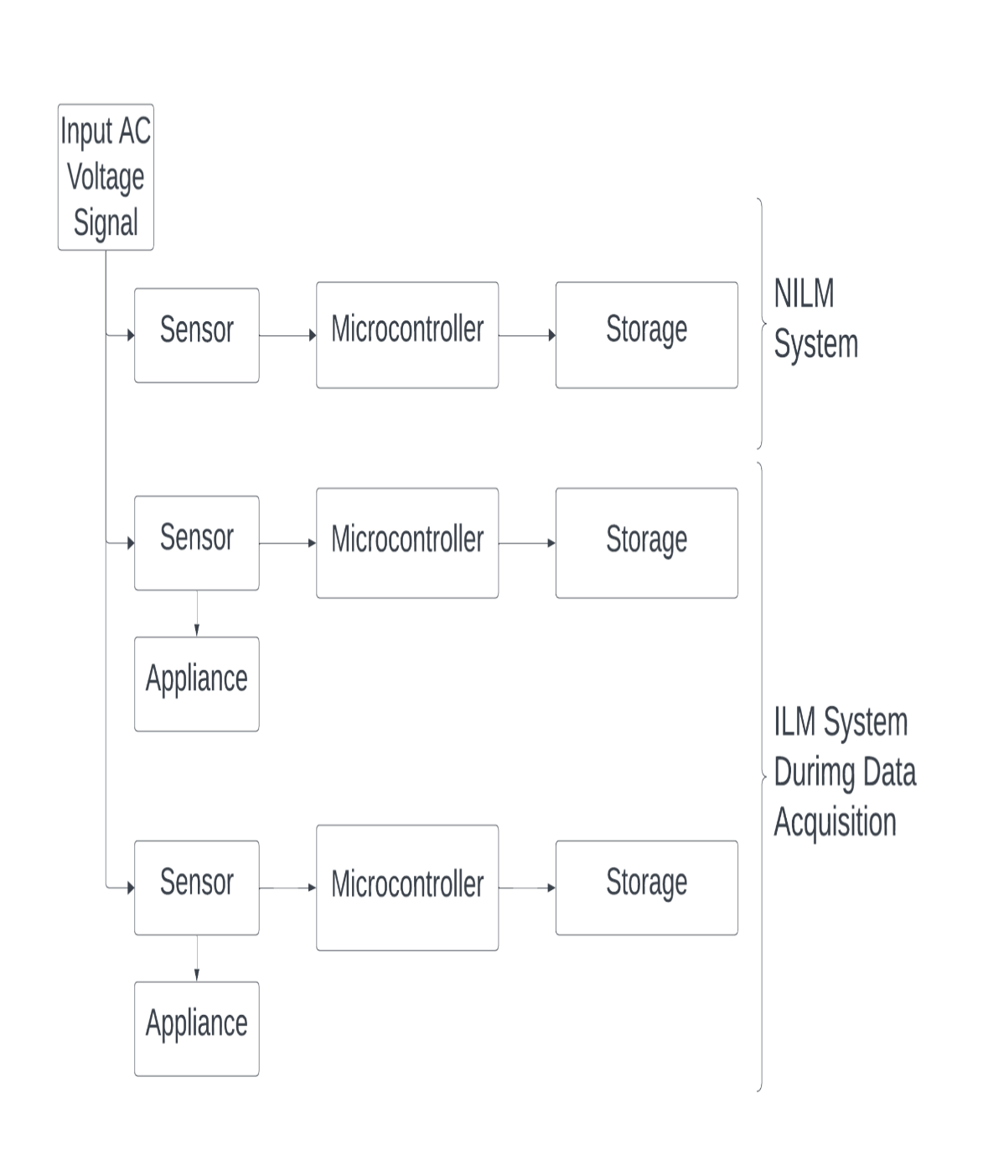
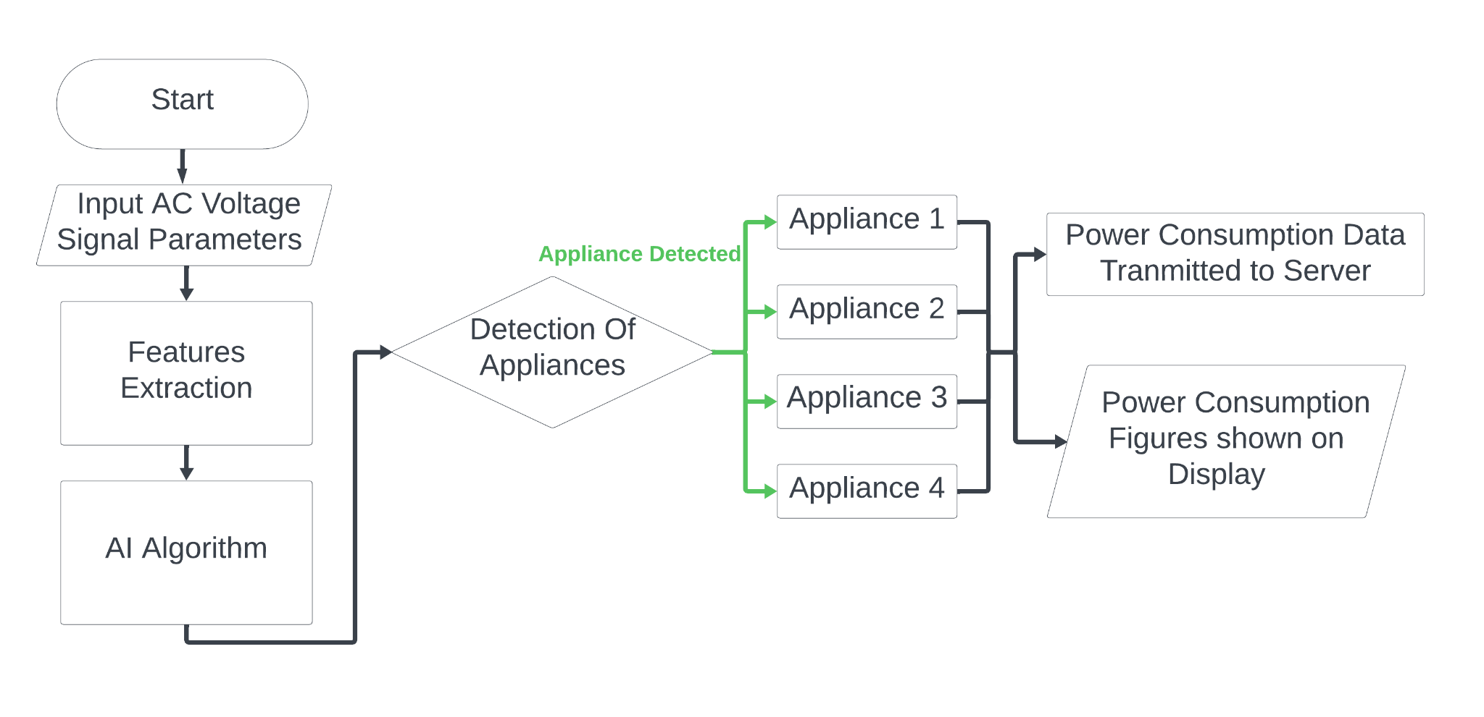
Methodology

Slide 6
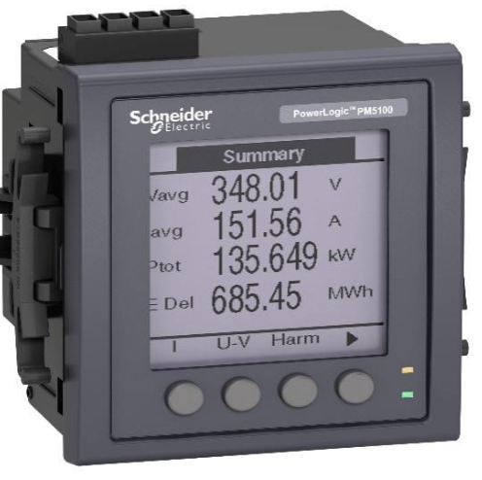
Product Specifications, Preliminary Design and Calculations
Real-Time Monitoring
Non-Intrusive Operation
AI Integration
User-Friendly Interface
Environmental Sustainability
Single Phase Meter
Voltage (RMS) = 140 to 300 V
I/I_{max}(RMS) = 5/100 A
Input Frequency = 50/60 Hz

Slide 7
Cost Analysis & Work Distribution
Components | Price
STM32 Nucleo Board | 16,000
ESP 32 (5) | 6,000
Sensors | 13,000
Storage Device | 20,000
Display & Other components | 5,000
Total | 60,000
Name | Work Assigned
MUHAMMAD SALMAN | Research and Development
MUHAMMAD MAHMOOD GHAURI | Code Implementation
MUHAMMAD MOIN DILDAR | PCB designing and Hardware implementation

Slide 8
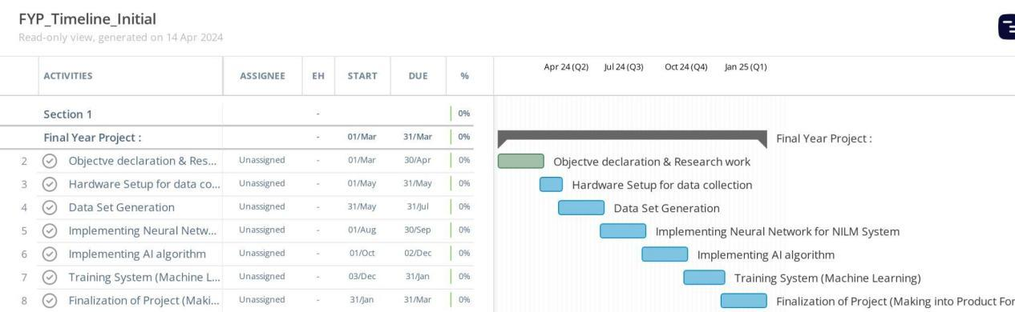
Timeline
References
[1] C. L. Athanasiadis T. A. Papadopoulos D. I. Doukas , "Real-Time Non-Intrusive Load Monitoring: A Light-Weight and Scalable Approach," Greece, 2024.
[2] M. I. Azad, R. Rajabi, A. Estebsari, "Non-Intrusive Load Monitoring (NILM) using Deep Neural Networks, IEEE, Madrid, Spain. 2023.
[3] S. Mari, . G. Bucci, . F. Ciancetta, . E. Fiorucci and A. Fioravanti, "An Embedded Deep Learning NILM System," in IEEE Transactions on Instrumentation and Measurement, L’Aquila, 2023.

